Slide 1
Introduction to Agent programming with JADE
Kirill Kipriianov

Slide 2
List of tutorials
Starting JADE Platform
JADE Platform and Containers
Simple Agent with different Behaviors
Receiving and sending Messages
Catalog of Services
Interaction Protocol
Ontology

Slide 3
Before begin
Install Eclipse (www.eclipse.org) or any IDE that supports MAVEN
Get sources for tutorial (https://github.com/gseteamproject/tutorials)

Slide 4
Tutorial 0
Starting JADE Platform

Slide 5
JADE Overview
JADE is a middleware that facilitates the development of multi-agent systems. It includes:
A runtime environment where JADE can “live” and that must be active on a given host before one or more agents can be executed on that host
A library of classes that programmers have to/can use (directly or by specializing them) to develop their agents
A suite of graphical tools that allows administrating and monitoring the activity of running agents

Slide 6
Tutorial 1
JADE Platform and Containers

Slide 7
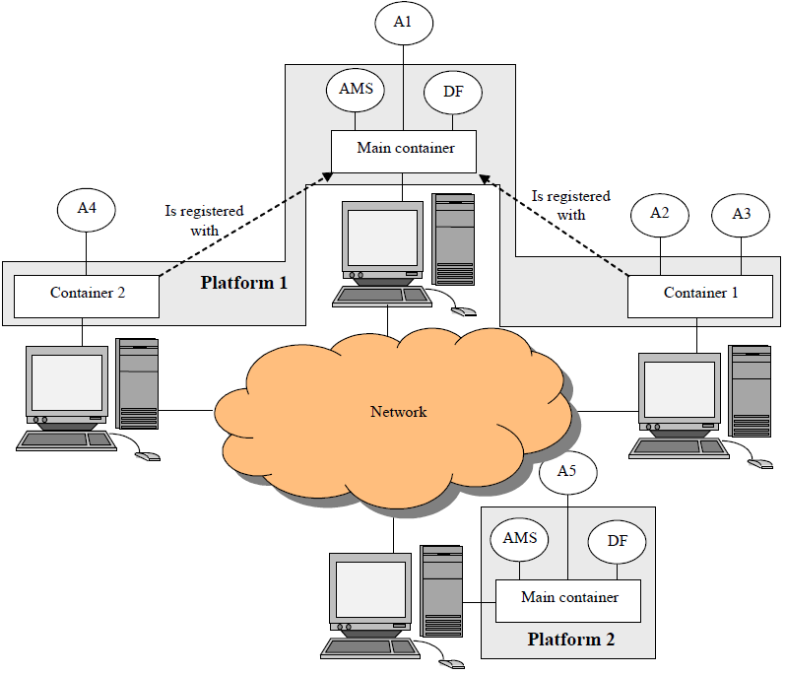
JADE Platforms and Containers
AMS – Agent Management System (platform management)
DF – Directory Facilitator (service dictionary)
A1-A5 – Agents
There are two JADE Platforms that are connected through the network
Platform 1 has one main container and two normal containers
Platform 2 has one main container
JADE Programming for beginners

Slide 8
Tutorial 2-3
Simple Agent with different Behaviors

Slide 9
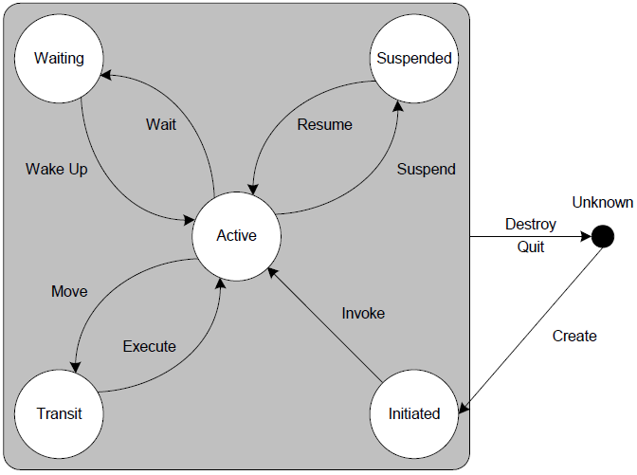
JADE Agent lifecycle
A JADE agent can be in one of several states, according to Agent Platform Life Cycle in
FIPA specification: Initiated, Active, Suspended, Waiting, Deleted, Transit
The Agent class provides public methods to perform transitions between the various states
Each functionality/service provided by an agent should be implemented as one or
more behaviours
JADE Programmer’s Guide

Slide 10
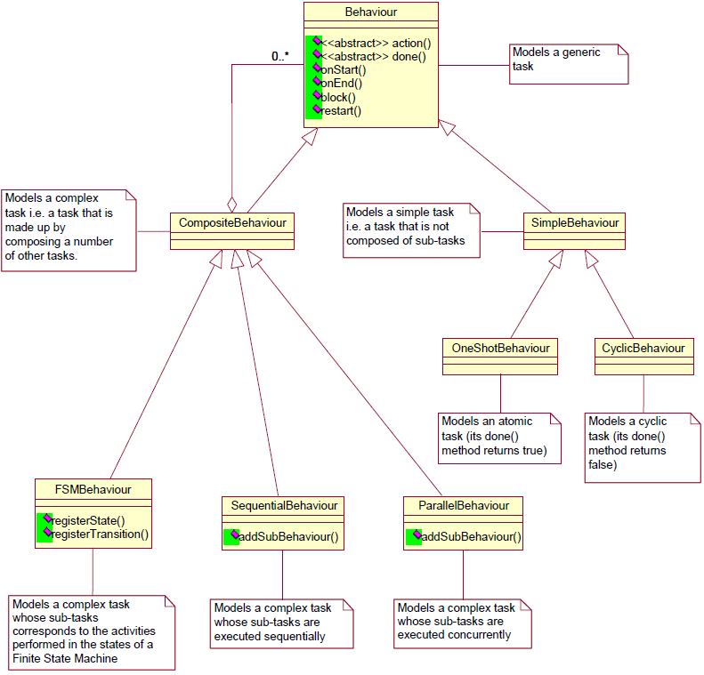
JADE Behaviors
Behaviors are used to implement agent activities
Each class extending Behavior must implement the action() method, that actually defines the operations to be performed when the behavior is in execution and the done() method, that specifies whether or not a behavior has completed and have to be removed from the pool of behavious an agent is carrying out.
JADE Programmer’s Guide

Slide 11
Tutorial 4
Receiving and sending Messages

Slide 12
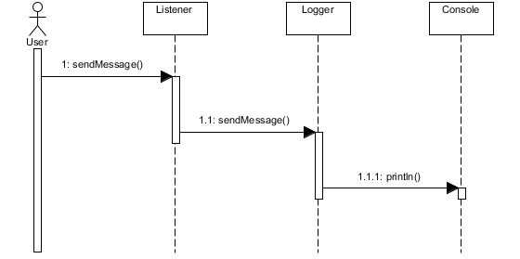
Receiving and sending Messages
User sends message to Listener through GUI Tools
Listener receives all messages and sends their content to Logger
Logger receives messages matching template and prints their content in standard output

Slide 13
Tutorial 5
Catalog of Services

Slide 14
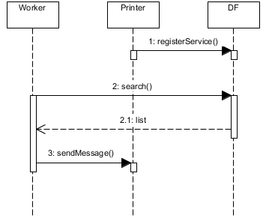
Catalog of Service
Printer registers itself as service provider in DF
Worker searches DF for agents providing service
DF replies with list of agents providing required service
Worker starts direct communication with agents from received list

Slide 15
Tutorial 6
Interaction Protocol

Slide 16
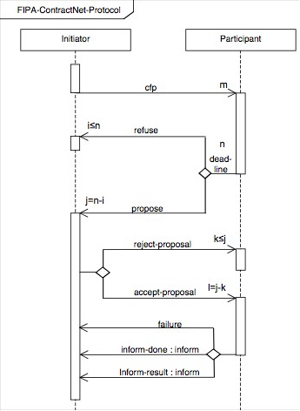
Interaction Protocol
Replace manual communicative act states handling with FIPA-Contract-Net-Protocol
http://www.fipa.org/specs/fipa00029/index.html

Slide 17
Tutorial 7
Ontology

Slide 18
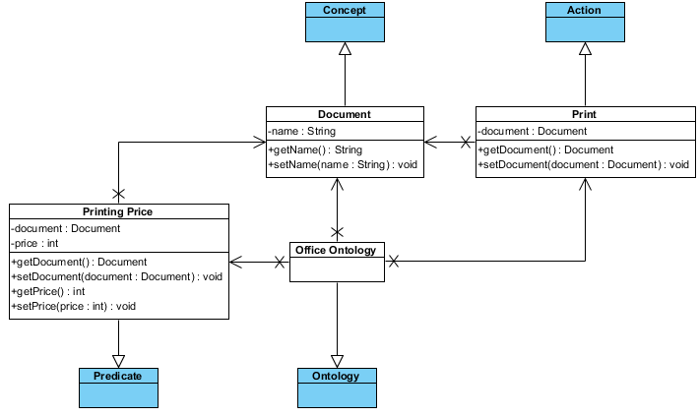
Ontology
Application-specific ontologies describe the elements that agents use to create the content of
Messages
This allows to create application specific ontologies and to use them independently of the adopted content language: the code that
implements the ontology and the code that sends and receives messages do not depend on the
content language.

Slide 19
References
JADE Official Site (http://jade.tilab.com/)
Eclipse (www.eclipse.org)
GitHub repository with tutorials (https://github.com/gseteamproject/tutorials)
GitHub repository with additional examples (https://github.com/gseteamproject/sandbox)
FIPA specifications (http://www.fipa.org/repository/aclspecs.html)

